Slide 1


Home Automation Using IOT
PROJECT GUIDE : JAYALAXMI N. DHANYAL
SUBMITTED BY : YOGITA DHOTE
3RD YEAR , G H RAISONI UNIVERSITY SAIKHEDA

Slide 2
ContentS
Introduction
C/C++ programming
IOT
Embedded systems
Micro-controllers
Project and its Objectives
Required Design Elements
Project simulation
Conclusion

Slide 3
INTRODUCTION
The Internet of things (IOT) has revolutionized the way we live , work , and interact with our surrounding .
One of the main advantages of home automation systems is energy efficiency.
Automating air conditioning, lighting, security, or communication translates to significant savings in energy consumption.
There is also an improvement in the quality of life of users who now have a home adapted to all their needs.

Slide 4
C PROGRAMMING
Data types (char , int , float , double)
Conditionals and Loops
Operators
Arrays and Pointers
Strings
Functions
Storage Classes
Pre-Processors

Slide 5
C++ PROGRAMMING
Classes
Object
Constructor
Destructor
Inheritance
Polymorphism
Encapsulation
Abstraction

Slide 6
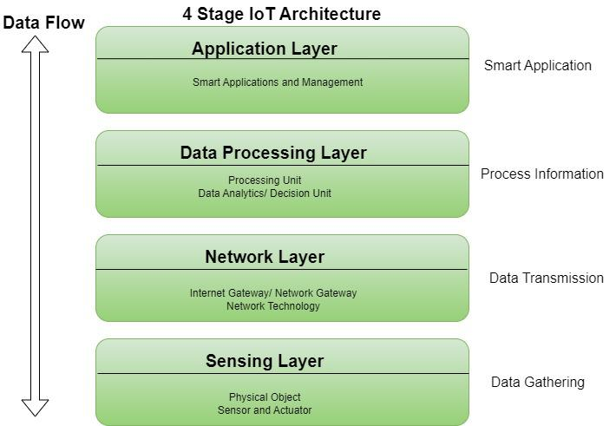
IOT (INTERNET OF THINGS )
IOT( Internet of Things) is the network of physical objects that contains embedded technology to communicate and interact with their internal states or the external environment .
Smart homes
Industrial Automation
Wearables
Transportation
Healthcare
Agriculture

Slide 7
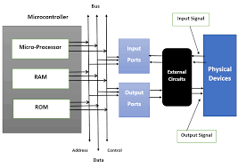
EMBEDDED SYSTEMS
Embedded system is a combination of its components- hardware ,software and firmwares designed to perform specific task / application .
Application of Embedded System are :
Home appliances
eg. Televisions , washing machines etc .
Transportation
eg. Engine management system in vehicles.
Health care
eg. Ultra sound machines .
Business sector & offices
eg. Printers , Cameras , Wireless routers etc.
Defense sector
eg. Missile , Motion detection , Submarine , etc .

Slide 8
MICRO-CONTROLLER
A microcontroller (MCU) is a small computer on a single integrated circuit that is designed to control specific tasks within electronic systems.
It combines the functions of a central processing unit (CPU), memory, and input/output interfaces, all on a single chip .
Application of Microcontrollers
Home appliances
Automotive system
Medical devices
Industrial control system

Slide 9
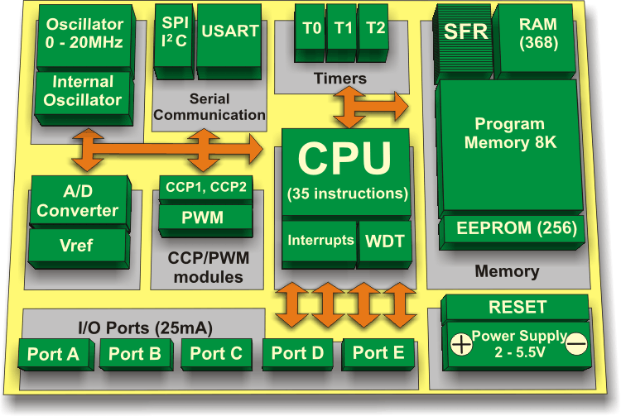
Components of Microcontroller
ADC (Analog to digital converter)
DAC (Digital to analog converter)
Timer Counter
PWM (Pulse width modulation)
Processor
Memory
I/O ports
RAM ( Random Access Memory)
ROM (Read only memory )

Slide 10
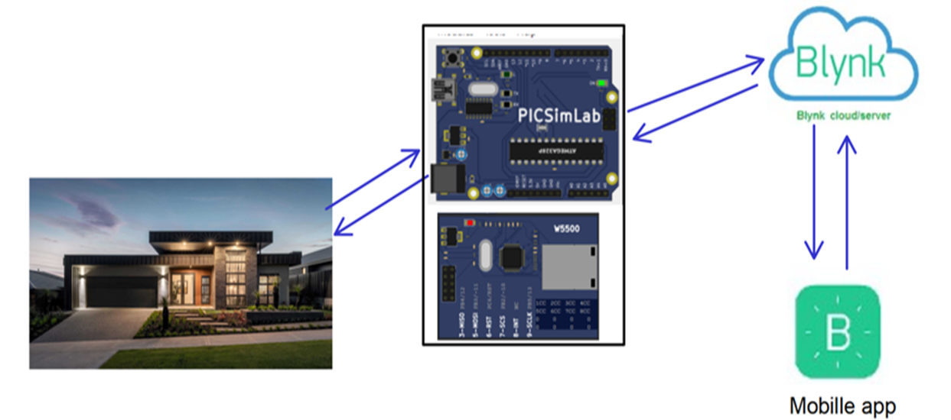
PROJECT
Aim of this project : To design and develop a IOT based home automation solution using Arduino UNO Board , Picsimlab simulator and Blynk IOT app.
The system will enable user to control and monitor
various home appliances remotely , like garden lights,
temperature system , and water tank system .
We can also check the real time status of
temperature system .
We can automate the garden lights where
they brighten according to sunlight .
We can monitor the volume of the water level
in the tank.

Slide 11
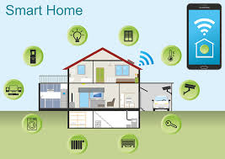
PROJECT OBJECTIVES
To design and develop a home automation using Arduino UNO Board .
Simulate the system using PicsimLab simulator .
Integrate the system with Blynk IOT app
for remote control and monitoring .
Automate home appliances based on
sensor data and user-defined setting.

Slide 12
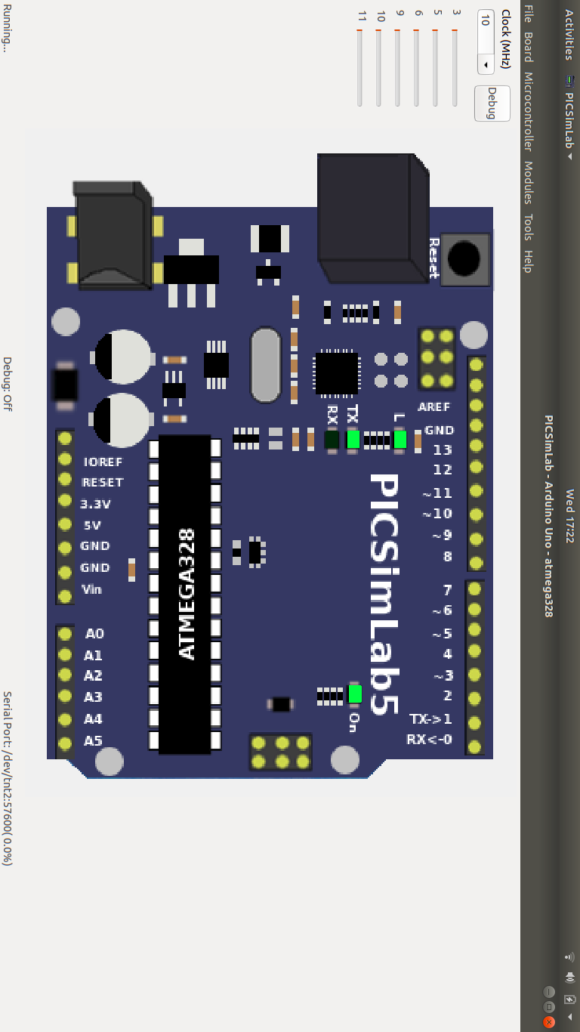
ARDUINO UNO BOARD
Arduino UNO is a microcontroller board based on the ATmega328P.
It has 14 digital input/output pins (of which 6 can be used as PWM outputs), 6 analog inputs, a 16 MHz ceramic resonator, a USB connection,
a power jack, an ICSP header and a reset button .
The ATmega328 on the board comes preprogrammed
with a bootloader that allows uploading new code to
it without the use of an external hardware
programmer .
The ATmega328P also features 1kb of EEPROM,
a memory which is not erased when powered off.

Slide 13
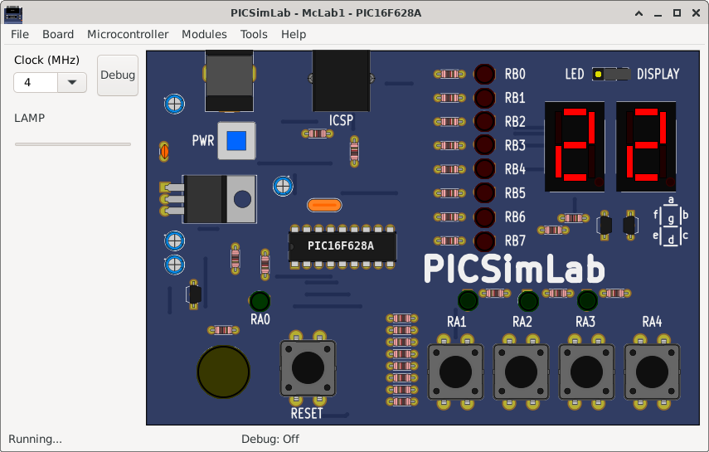
PICSIMLAB
PICSimLab is a realtime emulator of development boards with
MPLABX debugger integration.
PICSimLab has integration with MPLABX/Arduino IDE
for programming the microcontroller's boards.
As the purpose of PICSimLab is to emulate real hardware it
does not have any source code editing support.
For code editing and debugging the same tools used for a
real board should be used with PICSimLab, such as MPLABX,
Arduino IDE, or VSCode with PlatformIO.

Slide 14
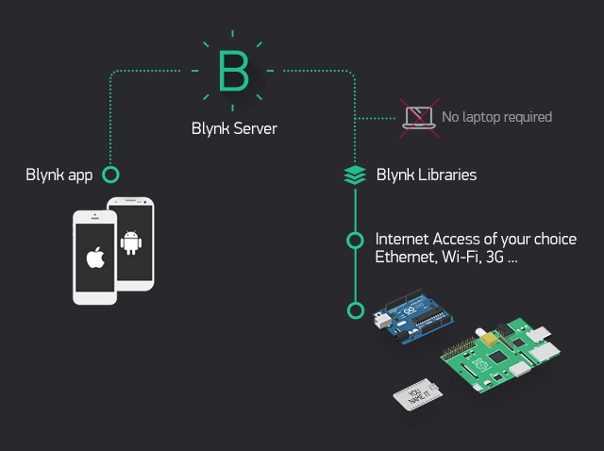
BLYNK IOT APP
Blynk is a full suite of software required to prototype, deploy, and remotely manage connected electronic devices at any scale: from personal IoT projects to millions of commercial connected products.
With Blynk anyone can connect their hardware to the cloud
and build a no-code iOS, Android, and web applications
to analyze real-time and historical data coming
from devices, control them remotely from
anywhere in the world, receive important
notifications.

Slide 15
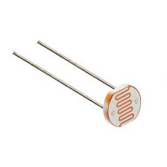
LDR ( LIGHT DEPENDENT RESISTOR)
LDR is an acronym for Light Dependent Resistor.
LDRs are tiny light-sensing devices also known as photoresistors.
An LDR is a resistor whose resistance changes as the amount of light falling on it changes.
The resistance of the LDR decreases with an increase in light intensity, and vice-versa.
This property allows us to use them for making light sensing circuits .
The led lights are connected to LDR via ADC . The ADC converts the analog input by LDR into its equivalent digital form which is converted later by certain formula from 0 to 255 as upper bound . Based on that we glow LED .

Slide 16
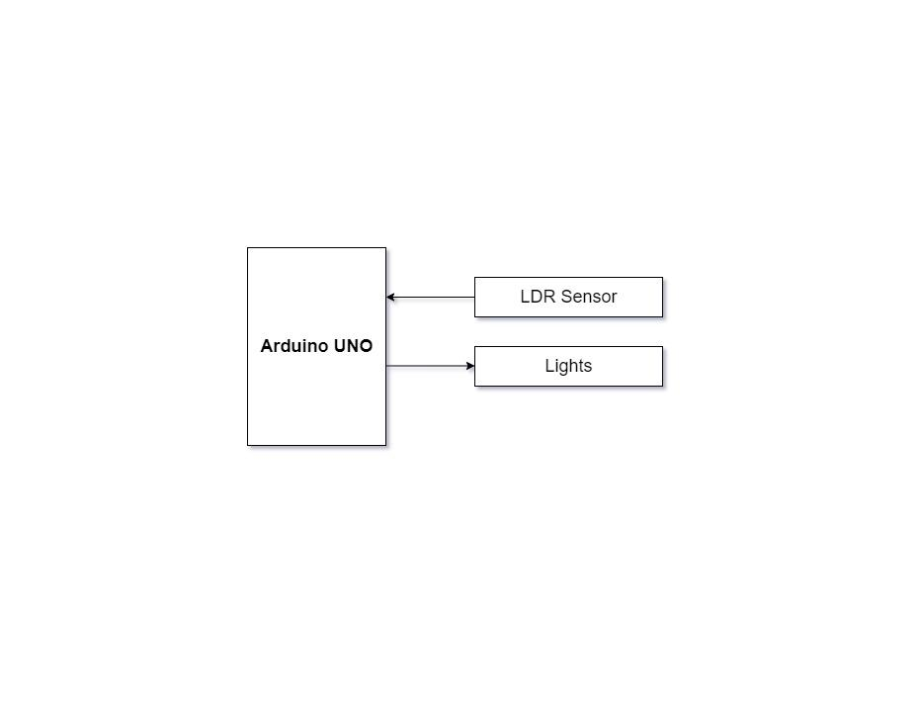
GARDEN LIGHT CONTROL
The properties of LDR sensor is applied to control the garden lights according to sunlight .
During the day the sunlight is maximum
so the LDR sensor detects the high light
and the garden light is turned OFF .
Whereas at the night the outdoor light
is minimum so the LDR sensor detects
the low light and the garden light
is turned ON .

Slide 17
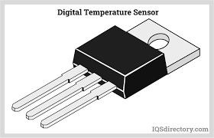
TEMPERATURE SENSOR
The temperature is recorded using LM35 sensor which reads analog values .
The value is converted into binary value and later actual temperature is calculated using the obtained value of voltage .
This sensor doesn’t require any external calibration to provide accuracies in result .

Slide 18
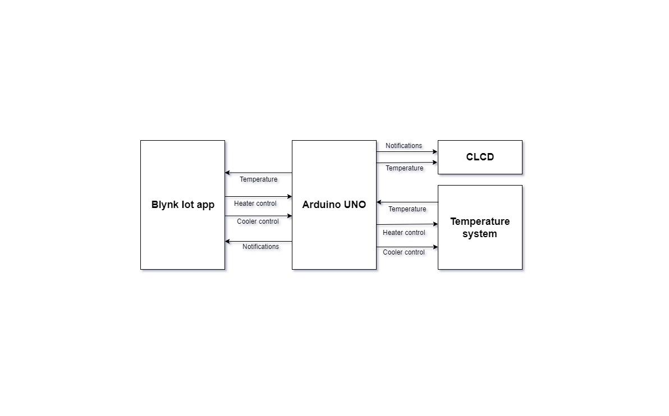
TEMPERATURE CONTROL SYSTEM
The temperature control system consists of heating resistors, an LM35 temperature sensor, and a cooler.
Analog value of a temperature is obtained,
temperature sensor LM35 and display it
on CLCD after converting it into
digital value using ADC.
Control the temperature of the system
by turning on/off the heater
and the cooler through the
Blynk IOT app .
The feature of these system is
that as temperature reaches 35°C ,
heater turns off automatically
to avoid more heating.

Slide 19
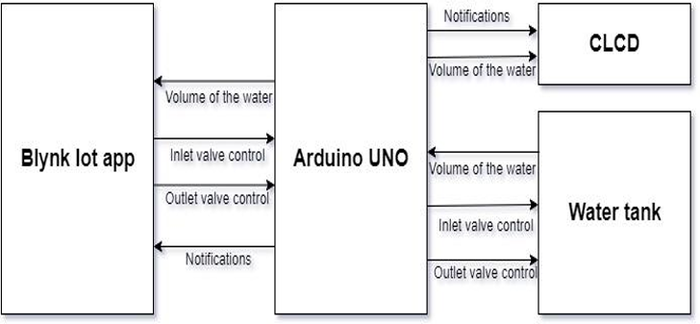
WATER CONTROL SYSTEM
Read the volume of the water in the tank through serial communication and display it on the CLCD.
Control the volume of the water in the tank
by controlling the inlet and outlet valve,
by sending commands through
serial communication.
Display the volume of the water
in the tank on the CLCD
using the Blynk IOT app.
Here, the main feature is that as soon as the
tank is full ,the inlet valve is turned off and
when the water level in the tank is
below 2000 L the inlet valve
is turned on automatically.

Slide 20
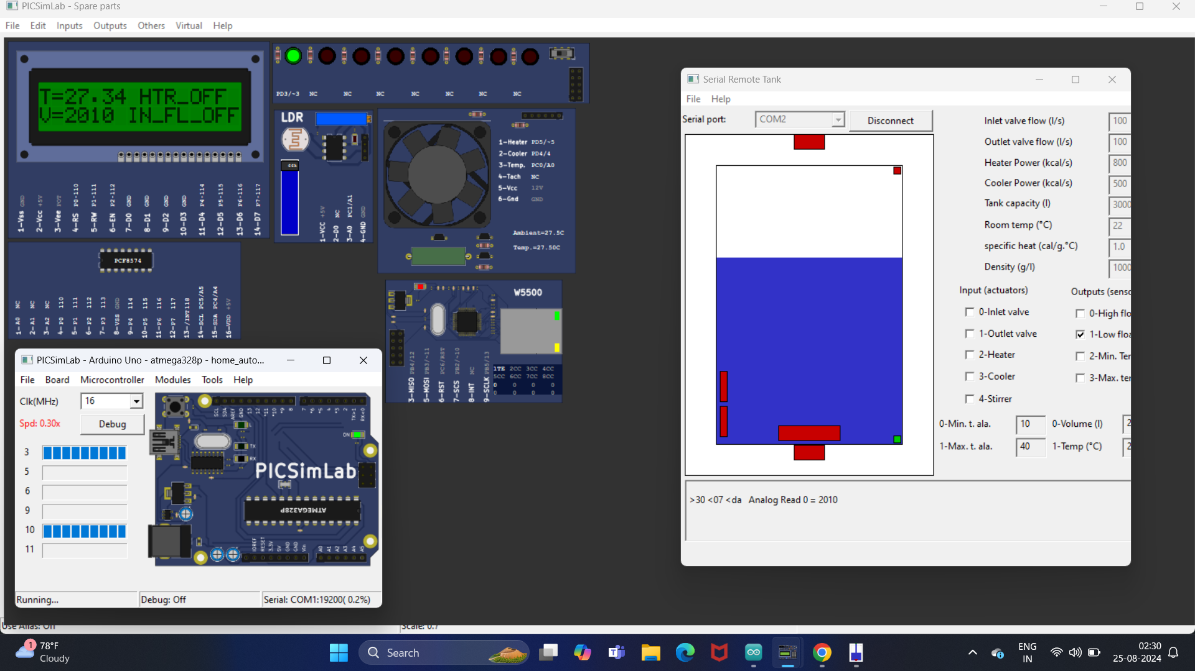
DESIGN ELEMENT

Slide 21
CONCLUSION
Using Blynk IOT application and Picsimlab simulator, we simulated home automation, where LED, temperature system, Serial tank resembles Light, Heater, Cooler and Water tank in real time.
CLCD acts like a dash board used for displaying the events. Widgets from Blynk IOT app like button widgets are used to control heater, cooler and inlet valve, outlet valve.
Gauge widgets to display the temperature and volume of the water.
Hence the project provides perfect solution for Home Automation.

Slide 22
THANK YOU!!

